Slide 1

OBJECT-ORIENTED PROGRAMMING (OOP) Week-1
Instructor:
Nida Munawar
Lecturer
(Computer Science Department)
National University- FAST (KHI Campus)

Slide 2


GCR code

Slide 3
acknowledgment
Publish
- Publish material by Virtual University of Pakistan.
Publish
- Publish material by Deitel & Deitel.
Publish
- Publish material by Robert Lafore.

Slide 4
What you have done so far !
- Programming Fundamentals (PF):
How to think a program.
How to write a program.
Basic Programming structure.
Procedural paradigm.
Group of functions that interact with each other.
- Already have knowledge about the offered course (Repeater’s Course).
- Need to strengthen our concepts.
- Try to implement what we know.

Slide 5

OO Programming as a course
What we will study:
Object Oriented Programming.
How to think in a OOP way.
How to map real world into a program
Or, how to program a real world scenario.
Aim :
Our aim is to lean the concepts of Object Oriented programming.
Try to digest them.
Implement in a program.
Tool: C++.

Slide 6
Contents of the Course
- Object Oriented Programming.
- Classes & Objects.
- Overloading.
- Inheritance.
- Polymorphism.
- Generic Programming.
- Exception Handling.

Slide 7
Books
Text Book:
1- C++ How to program By Deitel & Deitel.
Reference Books:
1- The C++ Programming Language By Bjarne Stroustrup.
2- Object Oriented Software Engineering By Jacobson.

Slide 8
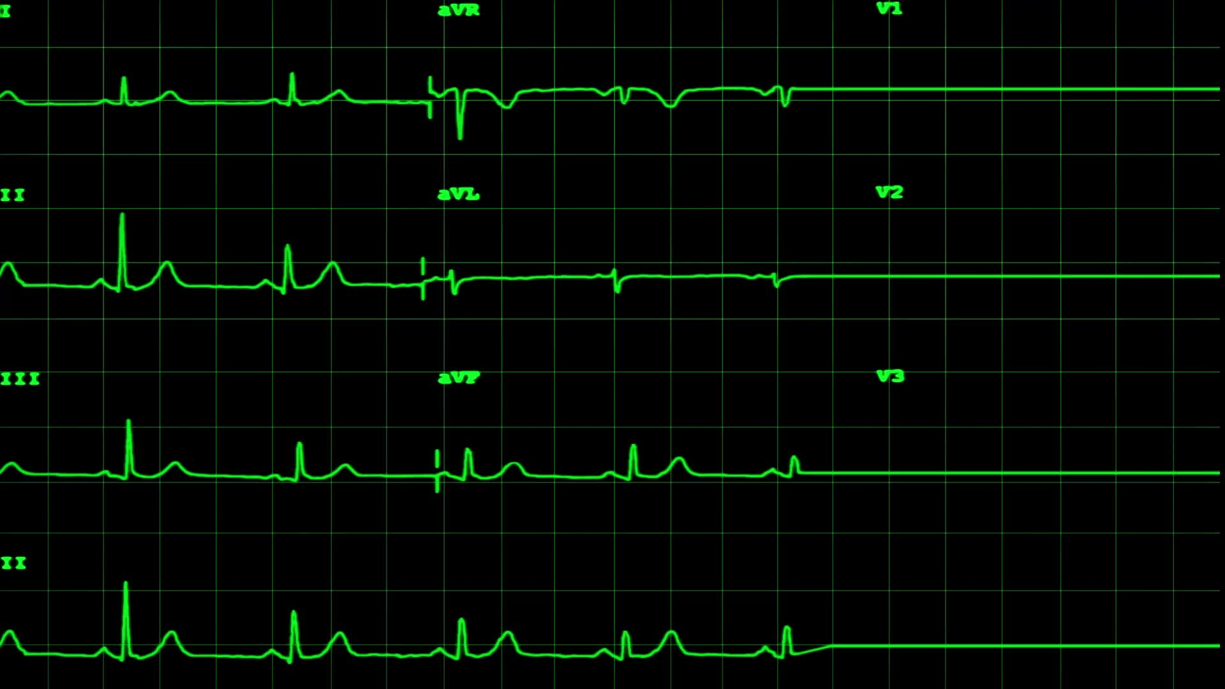
Grading policy
Assignments 10 at least three
Quiz 10 at least three(or N-1)
Midterm’s 30 two (15 marks each)
Final 50
_____
Total 100

Slide 9
Week One, class one
- Introduction to the Generation of Languages
- Introduction to Programming Paradigms

Slide 10
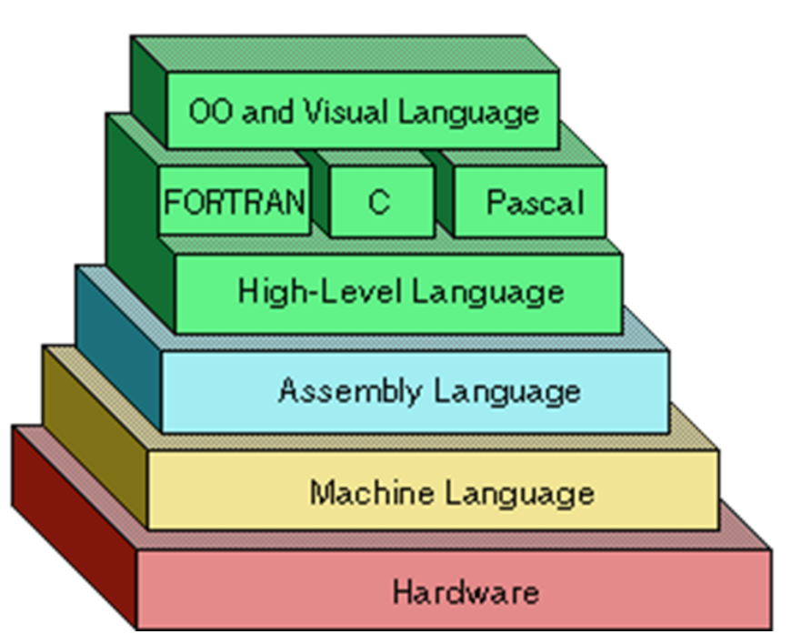
What Are the Types of Programming Languages

Slide 11
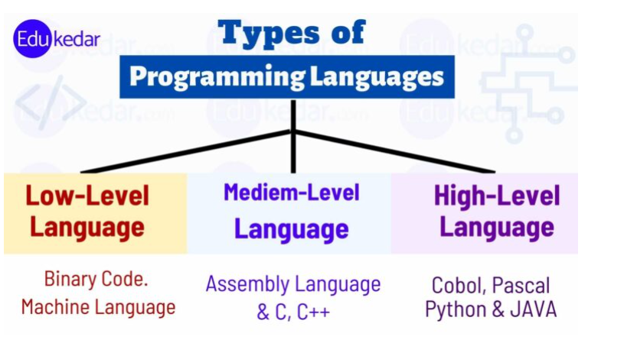
Types of Programming Languages

Slide 12
What Are the Types of Programming Languages
First Generation Languages
Second Generation Languages
Third Generation Languages
Fourth Generation Languages
Fifth Generation Languages

Slide 13
First Generation Languages
Machine language
Operation code – such as addition or subtraction.
Operands – that identify the data to be processed.
Machine language is machine dependent as it is the only language the computer can understand.
Very efficient code but very difficult to write.
(e.g., 01011100)
+1300042774
+1400593419
+1200274027 adds overtime pay to base pay and
stores the result in gross pay:

Slide 14
Second Generation Languages
Assembly languages
Symbolic operation codes replaced binary operation codes.
Assembly language programs needed to be “assembled” for execution by the computer. Each assembly language instruction is translated into one machine language instruction.
Very efficient code and easier to write.
(e.g., ADD, MOV)
load basepay
add overpay
store grosspay

Slide 15
Third Generation Languages
High Level Languages
Closer to English but included simple mathematical notation.
Programs written in source code which must be translated into machine language programs called object code.
The translation of source code to object code is accomplished by a machine language system program called a compiler.
grossPay = basePay + overTimePay;

Slide 16
Third Generation Languages (cont’d.)
Alternative to compilation is interpretation which is accomplished by a system program called an interpreter.
Common third generation languages
FORTRAN
COBOL
C and C++
Visual Basic

Slide 17
Fourth Generation Languages
Event based programming
A high level language (4GL) that requires fewer instructions to accomplish a task than a third generation language.
Used with databases
Query languages
Report generators
Forms designers
Application generators

Slide 18
Fifth Generation Languages
Artificial Intelligence
Machines that can think like humans
Machines that takes its own decisions

Slide 19
Programming Paradigms
The term paradigm = method to solve a problem
The term programming paradigm is used to specify an overall approach to writing program code
Many programming languages support multiple paradigms. Python, which is a popular general-purpose programming language, allows you to code using procedural, object-oriented.
In the early days of computer programming, most programs comprised a single procedure with many lines of code.

Slide 20
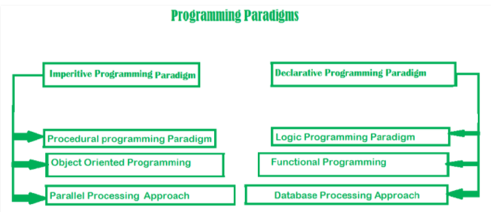
Programming Paradigms

Slide 21
The C++ language features most directly support four programming styles
Paradigm.
Procedural programming
Data abstraction
OOP programming
Generic programming
PP can be defined as a programming model which is derived from structured programming, based upon the concept of calling procedure. Procedures, also known as routines, subroutines or functions
This is programming focused on the design of interfaces, hiding implementation details in general and representations
OOP can be defined as a programming model which is based upon the concept of objects
This is programming focused on the design, implementation, and use
of general algorithms.

Slide 22
What is POP
A procedural language is a sort of computer programming language that has a set of functions, instructions, and statements that must be executed in a certain order to accomplish a job or program.
Procedural languages include BASIC, C, FORTRAN, and Pascal, to name a few.
features:
Modularity
Predefined Function
Scoping
Advantages
portable
Function
Flow Tracking
Disadvantages
large scale
not work for real world problem
Data Security

Slide 23
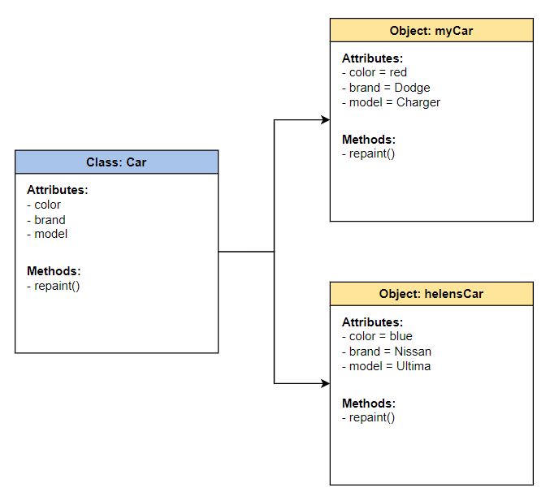
let’s talk about OOP
Object-Oriented Programming (OOP) is a programming paradigm in computer science that relies on the concept of classes and objects.
It is used to structure a software program into simple, reusable pieces of code blueprints (usually called classes),
which are used to create individual instances of objects.

Slide 24
Programming Paradigms
The procedural programming paradigm is where program code is divided up into procedures, discrete blocks of code that carry out a single task. procedural programming paradigm sometimes referred to as top-down problem-solving
Splitting code into smaller chunks has many benefits:
It is much easier to test and debug, e.g. tracing 20 lines of code instead of 200 lines of code.
procedures can be called many times, reducing the amount of repeated code.
procedures can manipulate shared data.

Slide 25
procedural vs object oriented
Data integrity
One criticism of the procedural paradigm is that it focuses on what needs to be done, rather than on the integrity of the data that it manipulates. The problem with global variables is that, since they can be accessed and modified by every subroutine in a program
procedure oriented programming languages follows top down approach
object oriented programming languages follows bottom up approach

Slide 26
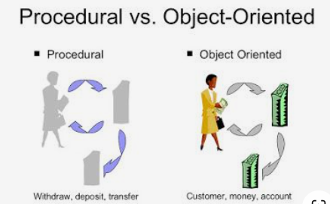
procedural vs object oriented

Slide 27
Programming Paradigms
The object-oriented programming paradigm (OOP) introduces a fundamentally different approach to problem-solving. Rather than focusing on the problem that needs to be solved, OOP focuses on the objects that make up the system.

Slide 28
Programming Paradigms
1- Sequential
2- Procedural
3- Object Oriented

Slide 29
Programming Paradigms
Data Oriented
Process Oriented
Object Oriented
Think in term of data that we needed
Think in term of Process that we needed
Think in term of Object that is involved

Slide 30
Week one, class two
- Introduction to OO paradigm
- Principles of Object Oriented Paradigm

Slide 31
What is object orientation
- A technique for system modeling.
- OO model consists of several interacting objects.

Slide 32
What is a Model?
- abstraction of something.
- Purpose is to understand the product before developing it.

Slide 33
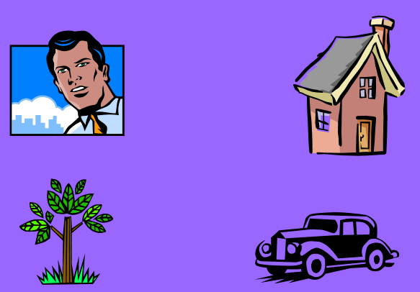
Example – OO Model

Slide 34
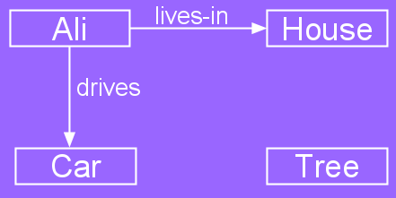
Example – OO Model
Objects
Person i.e Name: Ali
House
Car
Tree
Interactions
Ali lives in the house
Ali drives the car

Slide 35
Object-Orientation - Advantages
- People think in terms of objects
- OO models map to reality
Therefore, OO models are:
- easy to develop
- easy to understand

Slide 36
Five principles of OO paradigm
1- Abstraction: To have the relevant information.
2- Encapsulation: To hide information inside the object.
3- Polymorphism: To have many shapes / behaviors.
4- Inheritance: To create a new object with an existing one (To adopt features from others)
5- Reusability: Ability to use an object again and again if needed.

Slide 37
Five principles of OO paradigm
1- Abstraction: To have the relevant information.
2- Encapsulation: To hide information inside the object.
3- Polymorphism: To have many shapes / behaviors.
4- Inheritance: To create a new object with an existing one (To adopt features from others)
5- Reusability: Ability to use an object again and again if needed.

Slide 38
Inheritance
Inheritance is a features of OOP which allow the user to inherit the common properties from other class
For example, Class Vehicle and class bike and Class car
Types of inheritance:
Single
Multiple
Multivel
Hierarchical
Hybrid

Slide 39
Polymorphism
https://www.phptutorial.net/php-oop/php-polymorphism/
polymorphism refers to ability to exist in multiple form. Multiple interface can be given to a single interface
For example: First, define an abstract class named Person that has an abstract method called greet().
Type f Polymorphism:
Static / Compile time ( Overloading)
Dynamic/ Run time (Overriding)

Slide 40
Encapsulation
Encapsulation refers to binding the data and code that works on together in single unit.
For example: we have a class named as car and we have all the member functions and member variables wrapped inside this single unit and this binding of data is known as encapsulation.
Access Modifier:
Public
Private
Protected

Slide 41
Abstraction
Abstraction concept only allowing to display the important information and hide the implementation details from user.
Achieve by:
Abstract Class
Abstract Method

Slide 42
Real-life Example
We can take a real-life example of an Air conditioner (AC).
We have a remote control in order to control the various AC functions like start, stop, increase/decrease the temperature, control humidity, etc.
We can control these functions just with a clock of a button but internally there is a complex logic that is implemented to perform these functions.

Slide 43
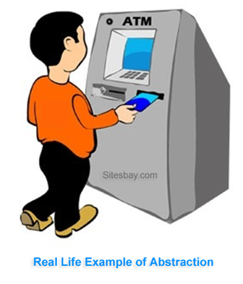
Data Abstraction (Example)

Slide 44
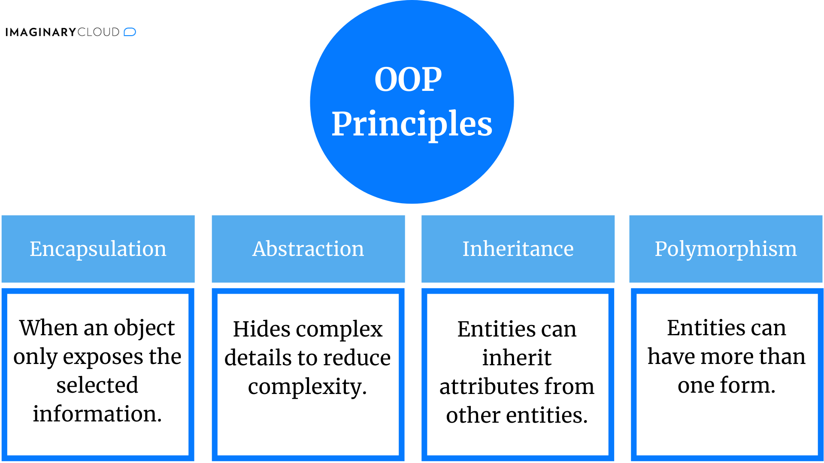
OOP Principle

Slide 45
Week one, class three
- Introduction to Object

Slide 46
What is an Object?
An object is:
- It can be anything for which we want to save Information
- Something tangible (Ali, Car)
- Something that can be captured intellectually (Time, date)
An object has:
State / attributes / properties / data
Well-defined behavior / methods / functions
Unique identity

Slide 47
Ali as an object
Attributes:
Name
age
Behavior (operations)
Walks
Eats
Identity
His name

Slide 48
Car as an Object
State (attributes)
Color
Model
Behavior (operations)
Accelerate
Start Car
Change Gear
Identity
Its registration number

Slide 49
Board marker as an object
Attributes?
Behavior?

Slide 50
Visualizing an Object
Functions/Methods/Behavior
Objects Data / Attributes / States

